Slide 1
Topic 5: Examining Categorical Data
STOR 155: Introduction to Data Models and Inference
Dr. Teressa Bergland
Fall 2025

Slide 2
Announcements + Warm-Up
Course PSAs:
Homework 4 due TODAY, Friday 9/05 on WebAssign
Homework 5 due Monday, 9/08
Warm-Up:
Brainstorm! Think of a categorical variable for something you’d like to study.
You can use the same population you proposed in Topic 2 or pick a new one!

Slide 3
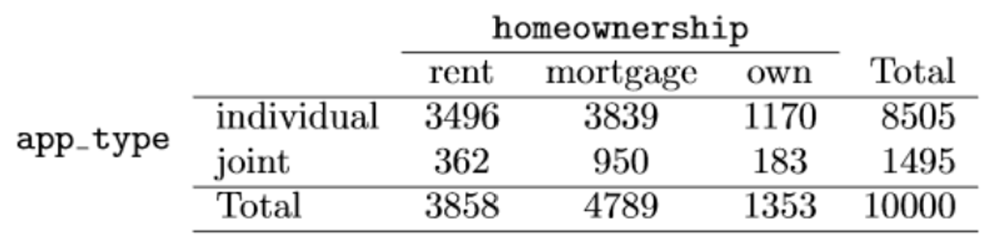
Contingency Tables
Question: Does there appear to be a relationship between loan application type and homeownership status?
Examine row proportions!

Slide 4
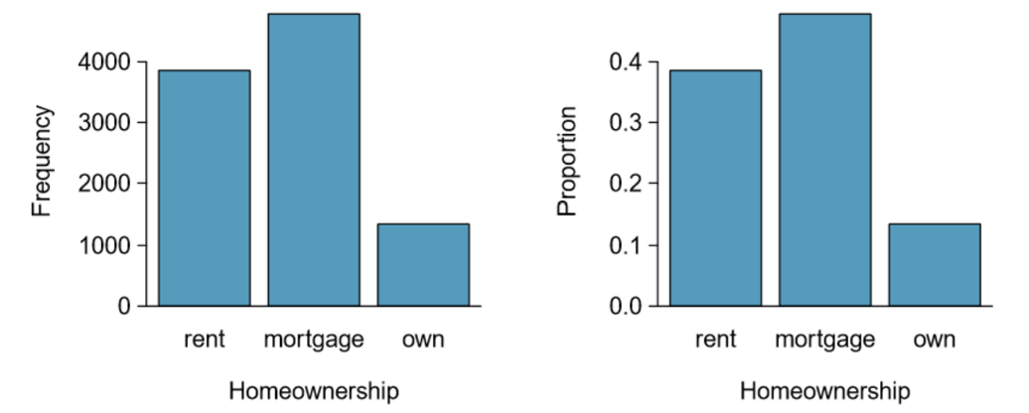
Bar Plots
Note: these are NOT histograms!

Slide 5
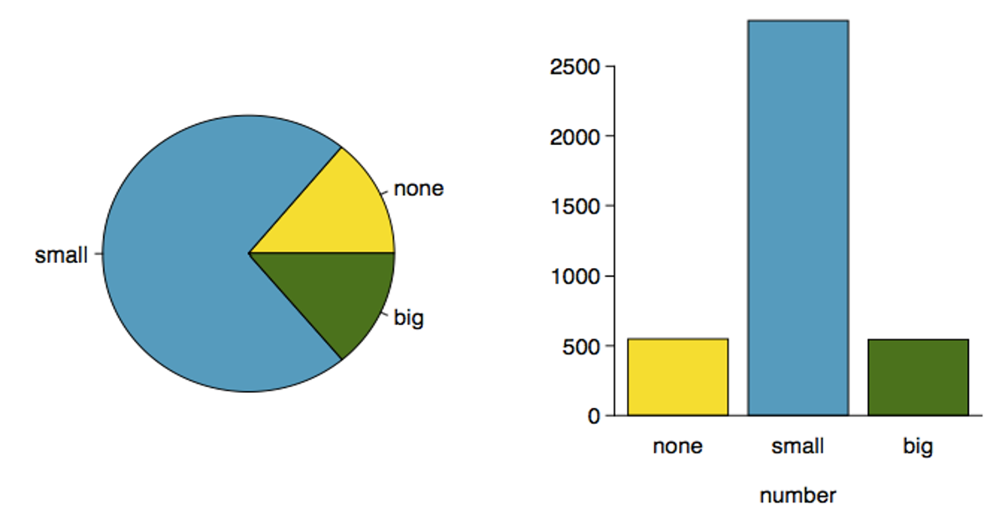
Pie Charts vs. Bar Plots

Slide 6
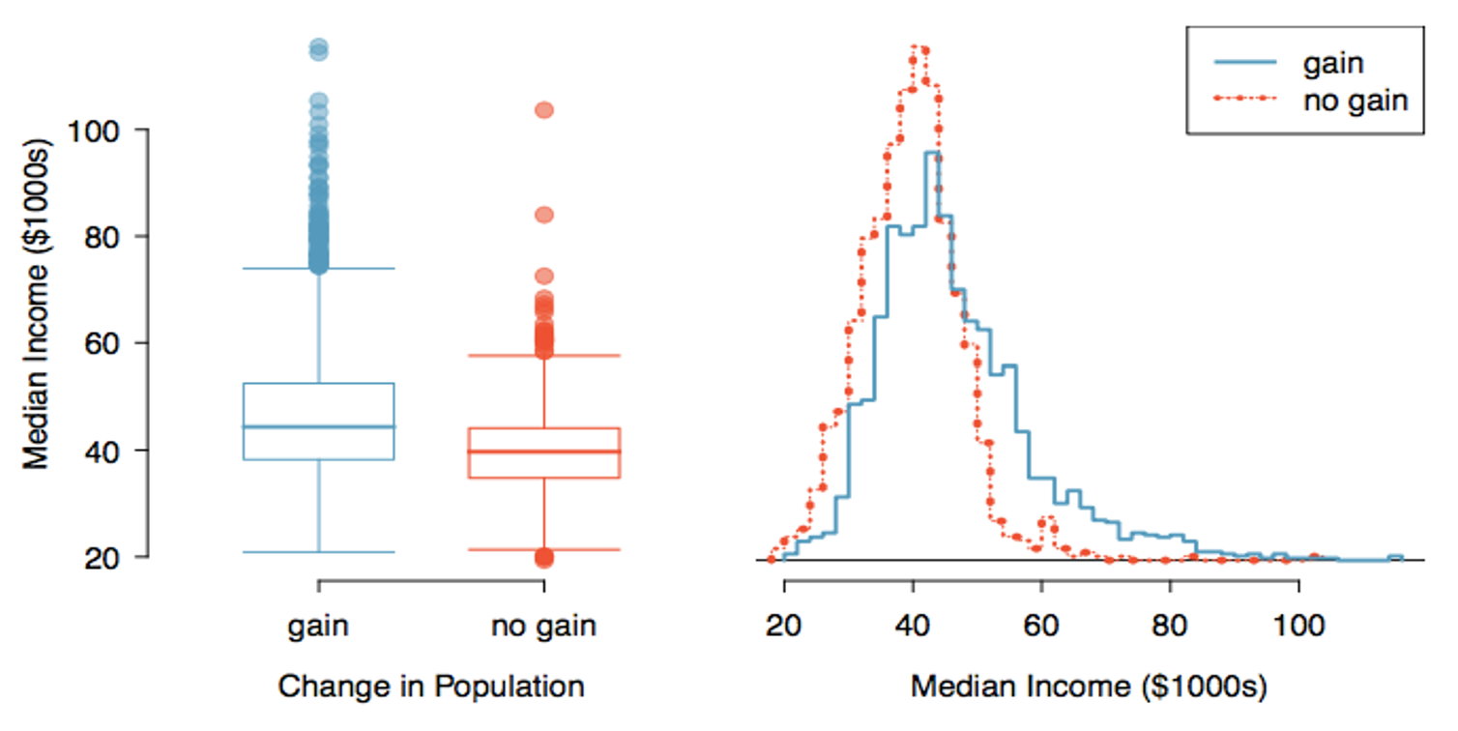
Side-by-Side Plots

Slide 7
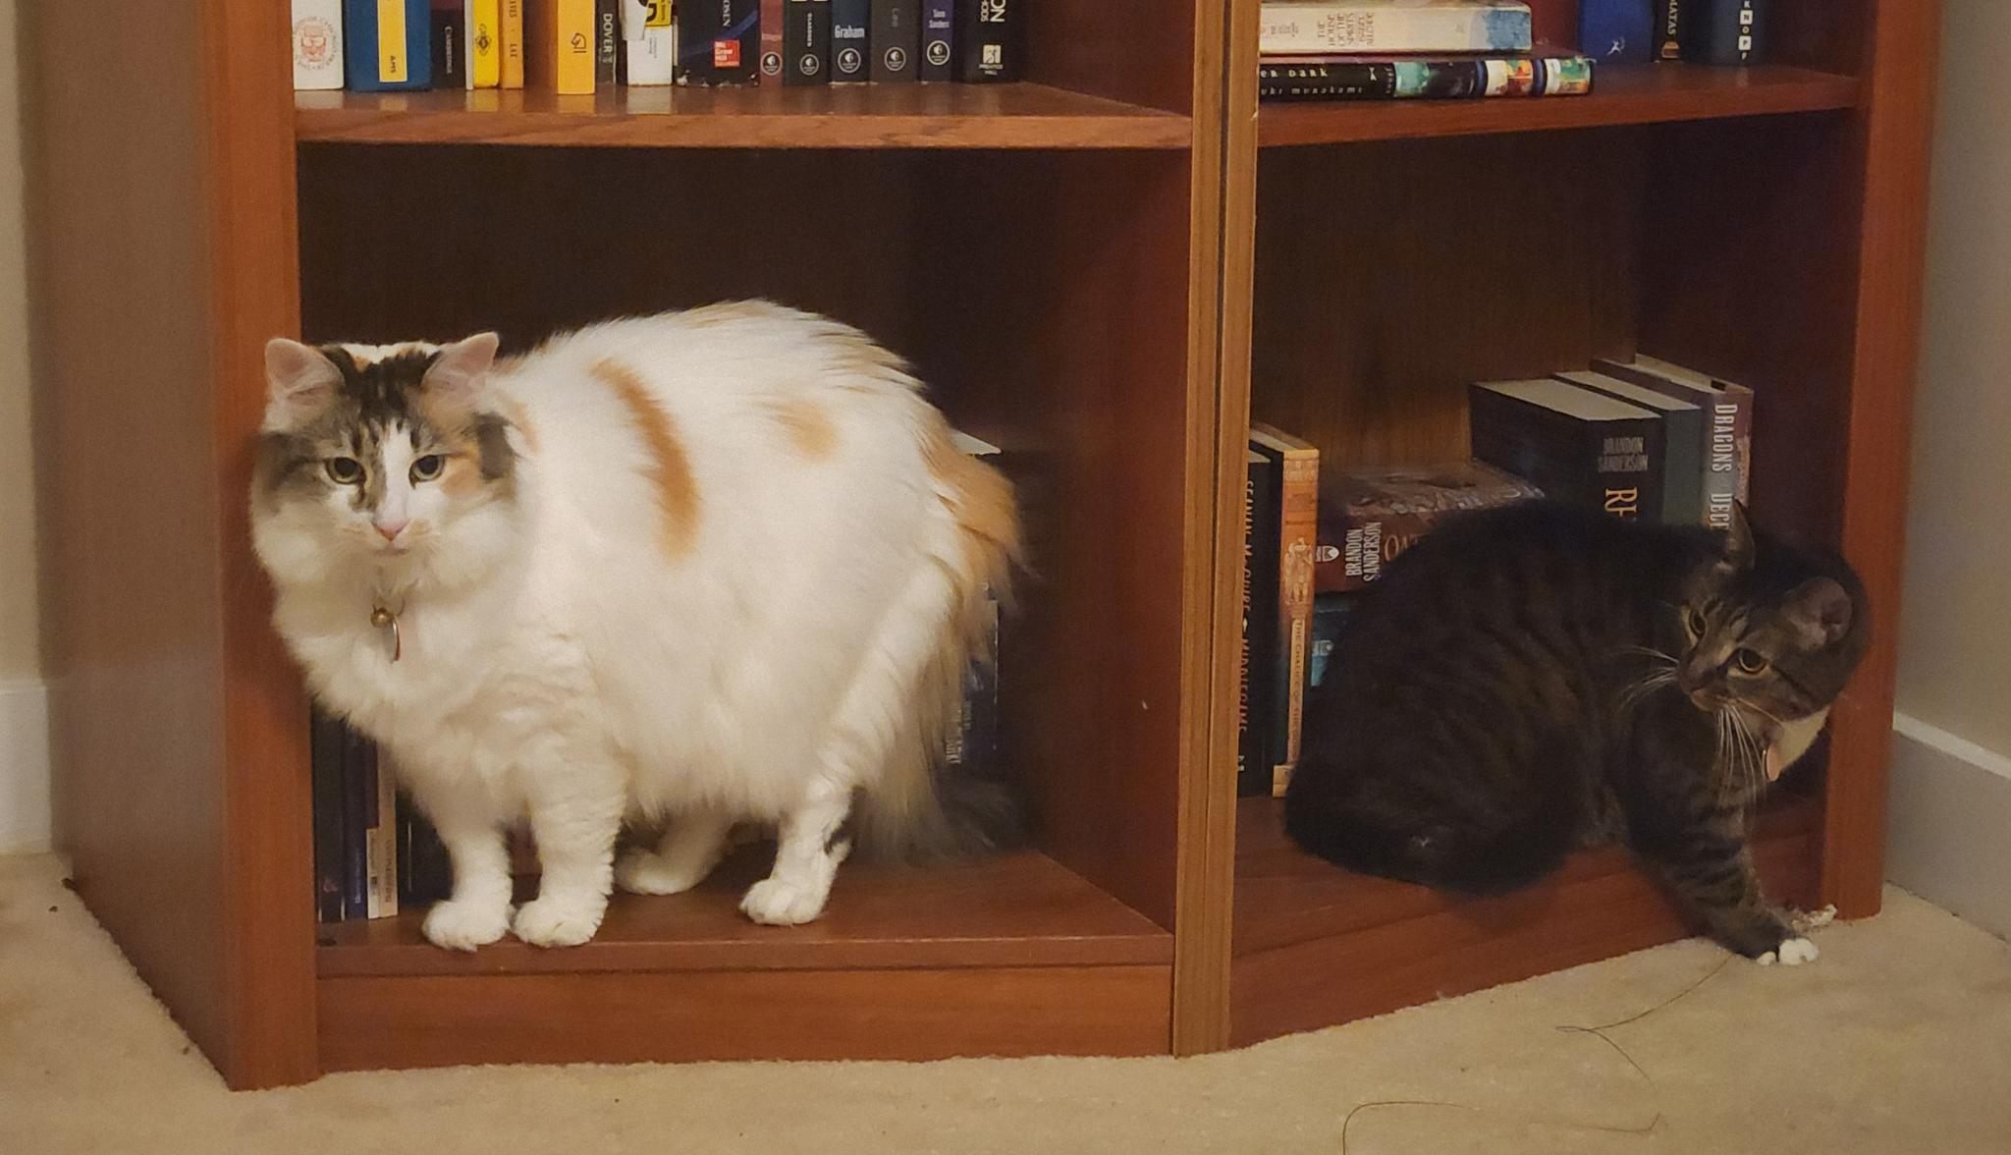
Congratulations!!!
That’s the end of Module 1! You now know all about data!

